Slide 1
Cache Memories
Program Optimization
MADE BY: Zhong Zhineng & Song Yixin

Slide 2
Cache Memories

Slide 3
Cache Memories
Small and fast SRAM memories
Keep frequently accessed blocks of main memory
Cache hit
Cache miss: three types of miss

Slide 4
Cache Structure
M, S, E, B, m, s
S cache sets, E cache lines, B blocks
t = m-(b+s) tag bits
Valid bit
C = S×E×B
Address of word: tag + set index + block offset
Bijection from middle s set index bits to S cache sets
Bijection from low b block offset bits to B blocks
2^t address of a cache set => t tag bits

Slide 5
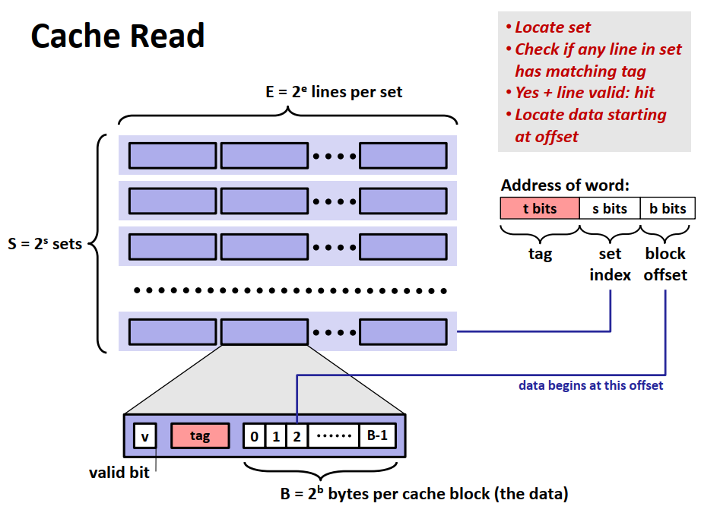
Cache Structure

Slide 6
Cache Classification
Direct Mapped Cache (E = 1)
Not match: old line being replaced directly
Thrash
Associative Cache (1 <E < C/B)
Not match: one line in the set is selected for eviction and replacement
Many replacement policies: Random, LRU, LFU, …
Fully Associative Cache (S = 1, E = C/B)
Search for many matching tags in parallel => expensive and small
TLB

Slide 7
Cache Write
Write hit
Write-through
Write-back
Write miss
Write allocate
No write allocate
Write through + No write allocate / Write back + Write allocate

Slide 8
Cache Friendly Code
Make use of locality
Make the most frequent the fast
Decrease cache miss within loops
Loop variable orders

Slide 9
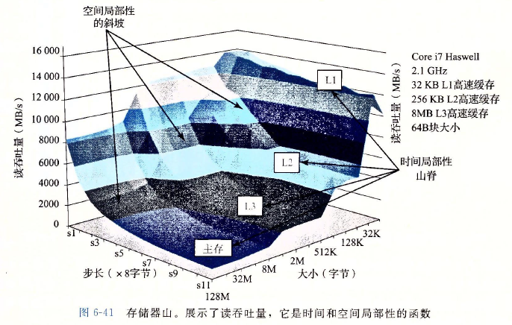
Cache Mountain

Slide 10
Program Optimization

Slide 11
Compiler Optimization
Some can be done by compiler
Code moving, such as moving the repeating calc inside the loop outside.
Use shift and add/sub to do mult/div
Expression reuse
Some cannot be done by compiler (must be conservative)
Procedure may have side-effects
Pointer may have aliases

Slide 12
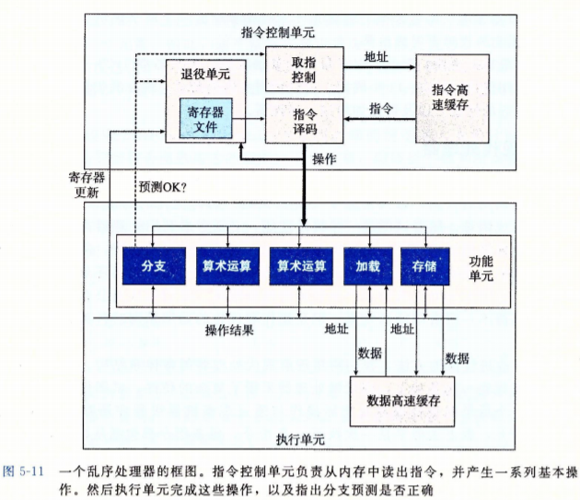
Simple Out-of-order Processor
CPI may be less than 1
In-order issue
Out-of-order execution
In-order commit

Slide 13
Modern CPU
Out-of-order execution
Multiple issue
Dynamic Scheduling
Speculative execution
Register renaming

Slide 14
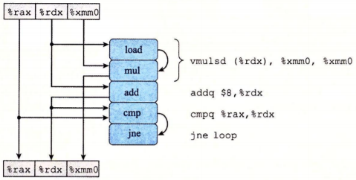
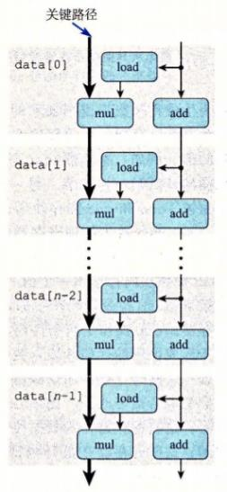
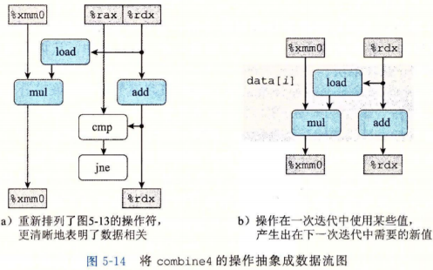
Critical Path
Critical path: lower bound
Number of function parts
Data passing limitation

Slide 15
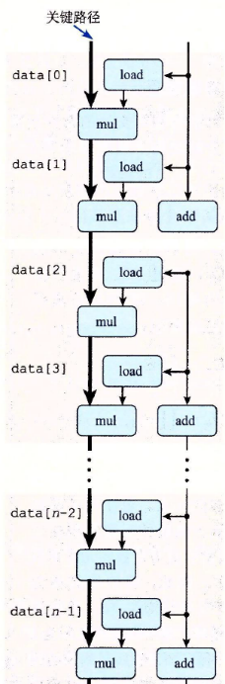
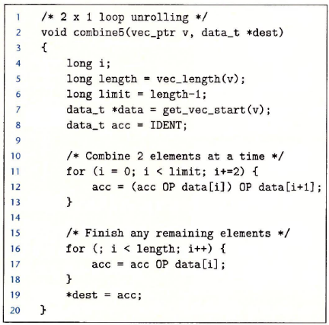
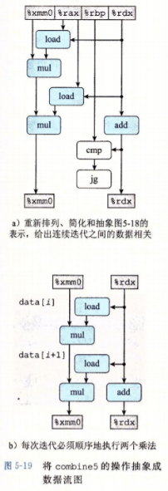
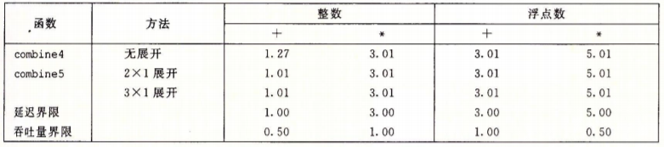
Loop Unrolling: Improve Parallelism

Slide 16
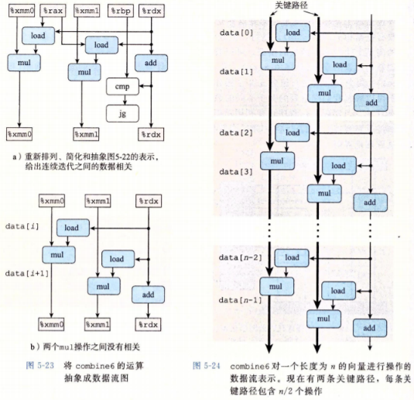
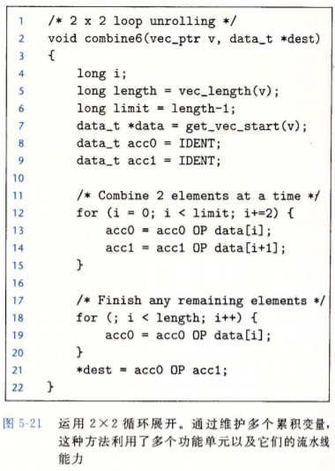
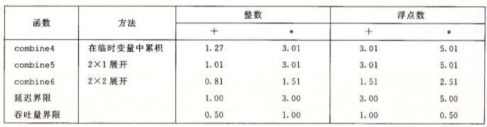
Separate Accumulators

Slide 17
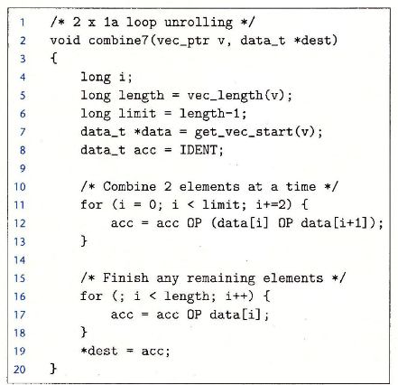
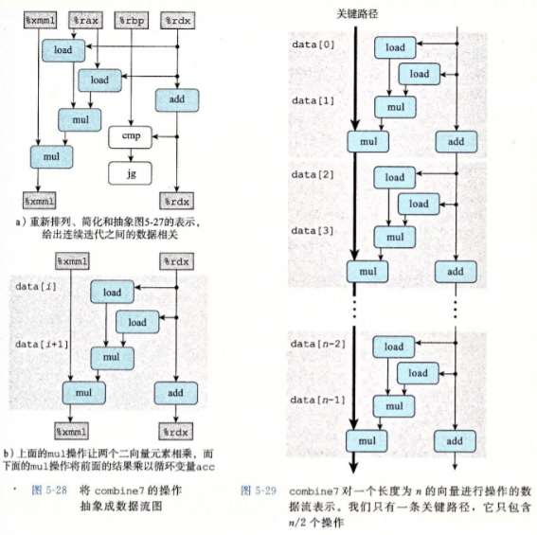
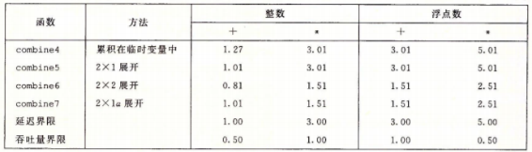
Reassociation

Slide 18
Limitations
Register spilling: k = 20, use stack to store
Floating operation does not have associative law, so changing operation orders may not apply.

Slide 19
Thanks for listening.

